Slide 1
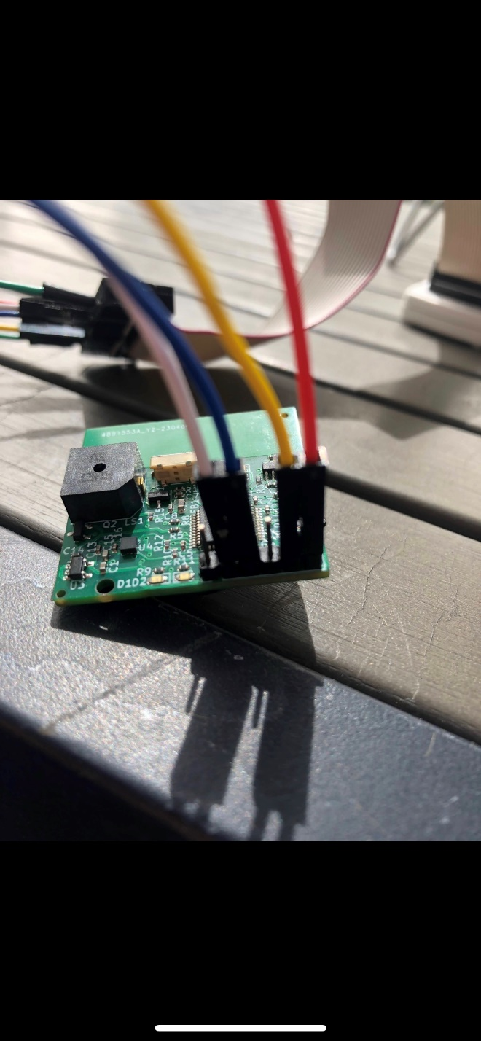
Phone
Belt
Proof of Concept Sprint

Slide 2
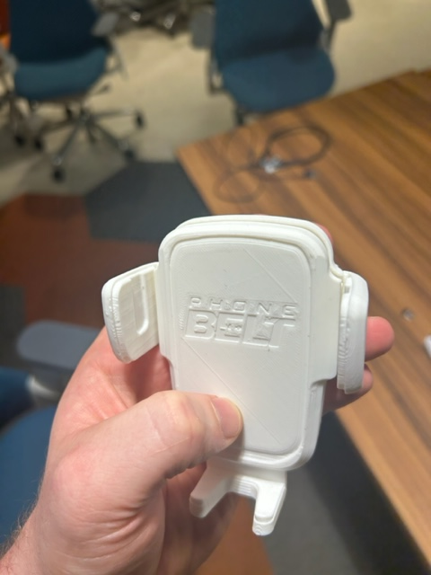
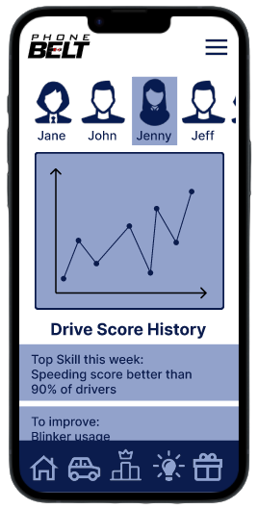

PhoneBelt
Prototyping Sprint

